Slide 1

Recursion

Slide 2




Ex. 1: The Handshake Problem
There are n people in a room. If each person shakes hands once with every other person. What is the total number h(n) of handshakes?
h(n) = h(n-1) + n-1
h(4) = h(3) + 3
h(3) = h(2) + 2
h(2) = 1
h(n): Sum of integer from 1 to n-1 = n(n-1) / 2

Slide 3
Recursion
In some problems, it may be natural to define the problem in terms of the problem itself.
Recursion is useful for problems that can be represented by a simpler version of the same problem.
Example: the factorial function
6! = 6 * 5 * 4 * 3 * 2 * 1
We could write:
6! = 6 * 5!

Slide 4
Example 2: factorial function
In general, we can express the factorial function as follows:
n! = n * (n-1)!
Is this correct? Well… almost.
The factorial function is only defined for positive integers. So we should be a bit more precise:
n! = 1 (if n is equal to 1)
n! = n * (n-1)! (if n is larger than 1)

Slide 5


factorial function
The C++ equivalent of this definition:
int fac(int numb){
if(numb<=1)
return 1;
else
return numb * fac(numb-1);
}
recursion means that a function calls itself

Slide 6
factorial function
Assume the number typed is 3, that is, numb=3.
fac(3) :
  3 <= 1 ? No.
  fac(3) = 3 * fac(2)
  fac(2) :
    2 <= 1 ? No.
    fac(2) = 2 * fac(1)
    fac(1) :
      1 <= 1 ? Yes.
      return 1
int fac(int numb){
if(numb<=1)
return 1;
else
return numb * fac(numb-1);
}
    fac(2) = 2 * 1 = 2
    return fac(2)
  fac(3) = 3 * 2 = 6
  return fac(3)
fac(3) has the value 6

Slide 7
factorial function
For certain problems (such as the factorial function), a recursive solution often leads to short and elegant code. Compare the recursive solution with the iterative solution:
Iterative solution
int fac(int numb){
int product=1;
while(numb>1){
product *= numb;
numb--;
}
return product;
}
Recursive solution
int fac(int numb){
if(numb<=1)
return 1;
else
return numb*fac(numb-1);
}

Slide 8
Recursion
We have to pay a price for recursion:
  calling a function consumes more time and memory than adjusting a loop counter.
  high performance applications (graphic action games, simulations of nuclear explosions) hardly ever use recursion.
In less demanding applications recursion is an attractive alternative for iteration (for the right problems!)

Slide 9
Recursion
If we use iteration, we must be careful not to create an infinite loop by accident:
for(int incr=1; incr!=10;incr+=2)
...
int result = 1;
while(result >0){
...
result++;
}
Oops!
Oops!

Slide 10
Recursion
Similarly, if we use recursion we must be careful not to create an infinite chain of function calls:
int fac(int numb){
return numb * fac(numb-1);
}
Or:
int fac(int numb){
if (numb<=1)
return 1;
else
return numb * fac(numb+1);
}
Oops!
No termination condition
Oops!

Slide 11
Recursion
We must always make sure that the recursion bottoms out:
A recursive function must contain at least one non-recursive branch.
The recursive calls must eventually lead to a non-recursive branch.

Slide 12
Recursion
Recursion is one way to decompose a task into smaller subtasks. At least one of the subtasks is a smaller example of the same task.
The smallest example of the same task has a non-recursive solution.
  Example: The factorial function
  n! = n * (n-1)! and 1! = 1

Slide 13

How many pairs of rabbits can be produced from a single pair in a year's time?
Assumptions:
  Each pair of rabbits produces a new pair of offspring every month;
  each new pair becomes fertile at the age of one month;
  none of the rabbits dies in that year.
Example:
  After 1 month there will be 2 pairs of rabbits;
  after 2 months, there will be 3 pairs;
  after 3 months, there will be 5 pairs (since the following month the original pair and the pair born during the first month will both produce a new pair and there will be 5 in all).

Slide 14
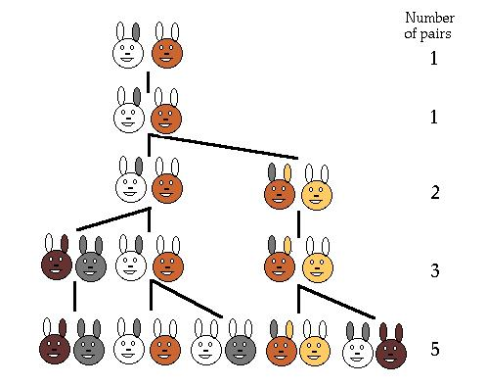
Population Growth in Nature
Leonardo Pisano (Leonardo Fibonacci = Leonardo, son of Bonaccio) proposed the sequence in 1202 in The Book of the Abacus.
Fibonacci numbers are believed to model nature to a certain extent, such as Kepler's observation of leaves and flowers in 1611.

Slide 15
Direct Computation Method
Fibonacci numbers:
  0, 1, 1, 2, 3, 5, 8, 13, 21, 34, ...
where each number is the sum of the preceding two.
Recursive definition:
  F(0) = 0;
  F(1) = 1;
  F(number) = F(number-1)+ F(number-2);

Slide 16
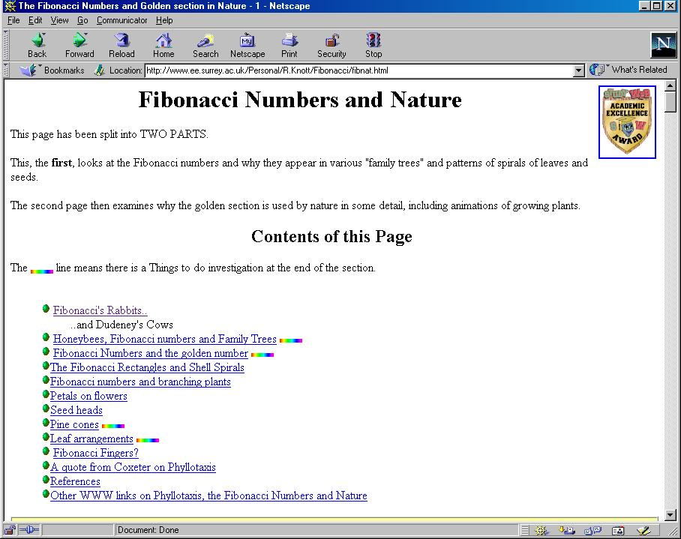

Slide 17
Example 3: Fibonacci numbers
//Calculate Fibonacci numbers using recursive function.
//A very inefficient way, but illustrates recursion well
int fib(int number)
{
if (number == 0) return 0;
if (number == 1) return 1;
return (fib(number-1) + fib(number-2));
}
int main(){ // driver function
int inp_number;
cout << "Please enter an integer: ";
cin >> inp_number;
cout << "The Fibonacci number for "<< inp_number
<< " is "<< fib(inp_number)<<endl;
return 0;
}

Slide 18
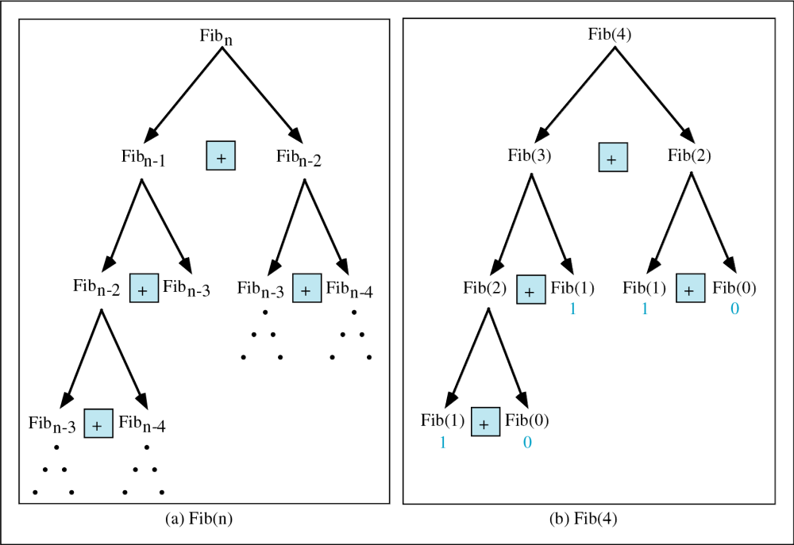
Copyright © 2000 by Brooks/Cole Publishing Company
A division of International Thomson Publishing Inc.

Slide 19
Trace a Fibonacci Number
int fib(int num)
{
if (num == 0) return 0;
if (num == 1) return 1;
return
(fib(num-1)+fib(num-2));
}
Assume the input number is 4, that is, num=4:
fib(4):
  4 == 0 ? No; 4 == 1? No.
  fib(4) = fib(3) + fib(2)
  fib(3):
    3 == 0 ? No; 3 == 1? No.
    fib(3) = fib(2) + fib(1)
    fib(2):
      2 == 0? No; 2==1? No.
      fib(2) = fib(1)+fib(0)
    fib(1):
    1== 0 ? No; 1 == 1? Yes.
    fib(1) = 1;
    return fib(1);

Slide 20
Trace a Fibonacci Number
fib(0):
    0 == 0 ? Yes.
    fib(0) = 0;
    return fib(0);
    fib(2) = 1 + 0 = 1;
    return fib(2);
  fib(3) = 1 + fib(1)
fib(1):
    1 == 0 ? No; 1 == 1? Yes
    fib(1) = 1;
    return fib(1);
  fib(3) = 1 + 1 = 2;
  return fib(3)

Slide 21
Trace a Fibonacci Number
fib(2):
      2 == 0 ? No; 2 == 1? No.
      fib(2) = fib(1) + fib(0)
      fib(1):
    1== 0 ? No; 1 == 1? Yes.
    fib(1) = 1;
    return fib(1);
    fib(0):
    0 == 0 ? Yes.
    fib(0) = 0;
    return fib(0);
    fib(2) = 1 + 0 = 1;
    return fib(2);
  fib(4) = fib(3) + fib(2)
  = 2 + 1 = 3;
  return fib(4);

Slide 22

Example 4: exponential func
How to write exp(int numb, int power) recursively?
int exp(int numb, int power){
if(power ==0)
return 1;
return numb * exp(numb, power -1);
}

Slide 23
Example 5: number of zero
Write a recursive function that counts the number of zero digits in an integer
zeros(10200) returns 3.
int zeros(int numb){
if(numb==0) // 1 digit (zero/non-zero):
return 1; // bottom out.
else if(numb < 10 && numb > -10)
return 0;
else // > 1 digits: recursion
return zeros(numb/10) + zeros(numb%10);
}
zeros(10200)
zeros(1020) + zeros(0)
zeros(102) + zeros(0) + zeros(0)
zeros(10) + zeros(2) + zeros(0) + zeros(0)
zeros(1) + zeros(0) + zeros(2) + zeros(0) + zeros(0)

Slide 24
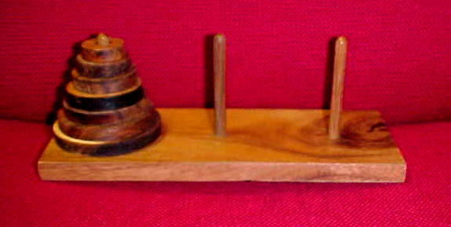
Example 6: Towers of Hanoi
  Only one disc could be moved at a time
  A larger disc must never be stacked above a smaller one
  One and only one extra needle could be used for intermediate storage of discs
see applet

Slide 25
Towers of Hanoi
void hanoi(int from, int to, int num)
{
int temp = 6 - from - to; //find the temporary
//storage column
if (num == 1){
printf("move disc 1 from %d”, from, " to %d”, to);
}
else {
hanoi(from, temp, num - 1);
printf("move disc %d”, num, " from %d”, from,
" to %d”, to);
hanoi(temp, to, num - 1);
}
}

Slide 26
Towers of Hanoi
int main() {
int num_disc; //number of discs
printf("Please enter a positive number (0 to quit))";
scanf(%d, &num_disc);
while (num_disc > 0){
hanoi(1, 3, num_disc);
printf("Please enter a positive number)";
scanf(%d, &num_disc);
}
return 0;
}

Slide 27
Output?
# include<stdio.h>
int main()
{
printf(“C to it that C survives\n”);
main();
return 0;
}
Notes:
The message will get printed indefintely

Slide 28
Output?
# include<stdio.h>
int main()
{
int i=0;
i++;
if(i<=5)
{
printf(”C add wings to your thoughts”);
exit(0);
main();
}
return 0;
}
Notes:
C add wings to your thoughts

Slide 29
Output?
Write a function to find the binary equivalent of this number:
Without using recursion
Using recursion
https://ideone.com/ya238Q
https://ideone.com/AbGQBZ
Notes:
https://ideone.com/AbGQBZ

